Slide 1
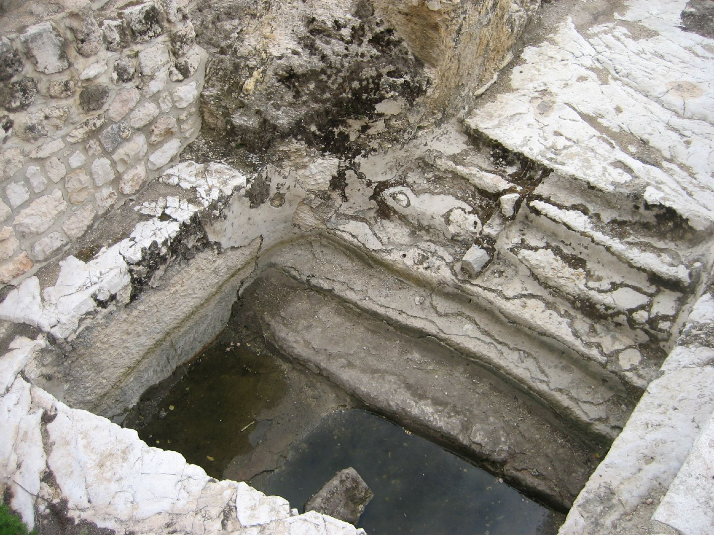

Slide 2
John 1:19-28
Who are You?
Are you someone who is a humble witness for Jesus Christ?
Are you someone whose identity is found in Jesus Christ?

