Slide 1
In preparation for John’s Gospel
John 21:20-25
Whose Disciple are You?
Do you believe that John’s Gospel is true?

Slide 2
Four Portraits of the One Jesus
Matthew | Mark | Luke | John
The Gospel of the Jewish Messiah | The Gospel of the suffering Son of God | The Gospel of the Saviour for all People | The Gospel of the divine Son who reveals the Father
Most structured | Most dramatic | Most thematic | Most theological

Slide 3
The Seven Sayings of Jesus from the Cross
Luke | John | Matthew/Mark
1. “Father, forgive them, for they do not know what they are doing.” 3. “I tell you the truth, today you will be with me in paradise.” 6. “Father, into your hands I commit my spirit.” | 2. To Mary: “Dear woman, here is your son.” To John: “Here is your mother.” 4. “I am thirsty.” 7. “It is finished.” | 5. “My God, my God, why have you forsaken me?”

Slide 4
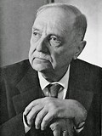
In the early communities, the Gospel stories were created and embellished with legend and myth.
The Gospels are not historical biographies but theological propaganda created to reflect the community’s beliefs.
Rudolf
Bultmann
(1884-1976)

Slide 5
In preparation for John’s Gospel
John 21:20-25
Whose Disciple are You?
Do you believe that John’s Gospel is true?
Do you believe miracles are possible?

Slide 6
Basic Outline of John’s Gospel
Prologue……………. John 1:1-18
Book of Signs……… John 1:19-12:50
Book of Glory……… John 13:1-20:31
Epilogue……………. John 21:1-25

Slide 7
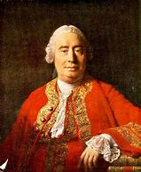
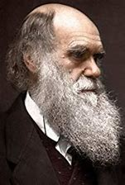
Men Who Rule the World from the Grave
David Hume
(1711-1776)
Human experience confirms the certainty
and inviolability of the laws of nature. Since miracles are by definition violations of these laws, it would take an overwhelming amout of evidence to confirm any miracle. Belief in miracles is therefore irrational.

Slide 8
1. No miracle has ever been attested by a sufficient number of educated and rational witnesses to be proven true
2. There is a human tendency to
believe the spectacular, things
that cause wonder and surprise
3. Most reports of miracles occur among ignorant and barbarous people
4. Claims of miracles occur in all religious traditions, thus nullifying one another

Slide 9
In preparation for John’s Gospel
John 21:20-25
Whose Disciple are You?
Do you believe that John’s Gospel is true?
Do you believe miracles are possible?

